Slide 1
House Price Prediction
Radhika Reddy
Kusala Nagamani Reddy
Date : 04/15/2024

Slide 2
Objective:
To conduct a comprehensive analysis of various factors influencing house prices.
Provide stakeholders with accurate price predictions through data-driven insights for informed decision-making in real estate transactions.
Dataset contains more than 21k records and 23 columns.
Combination of numerical and categorical.
Sourced from Kaggle.

Slide 3
Data description:
Feature | Description
price | Price (prediction target)
room_bed | Number of bedrooms in the house
room_bath | Number of bathrooms per bedroom
living_measure | Square footage of the home
lot_measure | Square footage of the lot
ceil | Total floors (levels) in the house
coast | Presence of a view of waterfront
sight | Whether the property has been viewed
condition | Overall condition of the property
quality | Grade given to the housing unit based on a grading system
ceil_measure | Square footage of the house apart from the basement
basement_measure | Square footage of the basement
furnished | Based on the quality of the room
total_area | Measure of both living and lot areas

Slide 4
Variables to analyze and predict the house prices:
price | 600000 | 190000 | 735000 | 257000 | 450000
room_bed | 4 | 2 | 4 | 3 | 2
room_bath | 1.75 | 1 | 2.75 | 2.5 | 1
living_measure | 3050 | 670 | 3040 | 1740 | 1120
lot_measure | 9440 | 3101 | 2415 | 3721 | 4590
ceil | 1 | 1 | 2 | 2 | 1
coast | 0 | 0 | 1 | 0 | 0
sight | 0 | 0 | 4 | 0 | 0
condition | 3 | 4 | 3 | 3 | 3
quality | 8 | 6 | 8 | 8 | 7
ceil_measure | 1800 | 670 | 3040 | 1740 | 1120
basement | 1250 | 0 | 0 | 0 | 0
yr_built | 1966 | 1948 | 1966 | 2009 | 1924
yr_renovated | 0 | 0 | 0 | 0 | 0
zipcode | 98034 | 98118 | 98118 | 98002 | 98118
lat | 47.7228 | 47.5546 | 47.5188 | 47.3363 | 47.5663
long | -122.18 | -122.27 | -122.26 | -122.21 | -122.29
living_measure15 | 2020 | 1660 | 2620 | 2030 | 1120
lot_measure15 | 8660 | 4100 | 2433 | 3794 | 5100
furnished | 0 | 0 | 0 | 0 | 0
total_area | 12490 | 3771 | 5455 | 5461 | 5710

Slide 5
Data Pre-processing:
Identifying numerical and categorical variables.
Identifying and addressing issues with the data.
Plotting the date and zip code plots.
Missing value treatment.
Identifying if there are outliers in data.
Data Visualization.

Slide 6
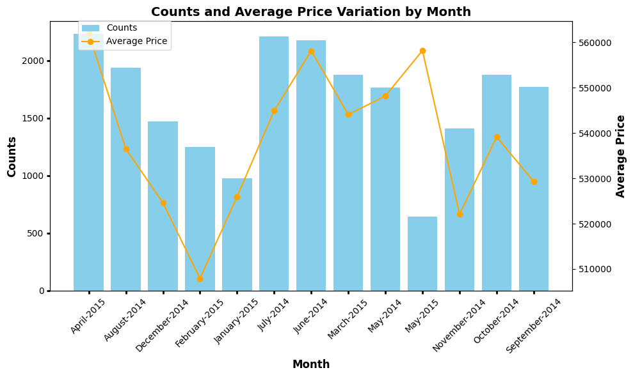

Slide 7
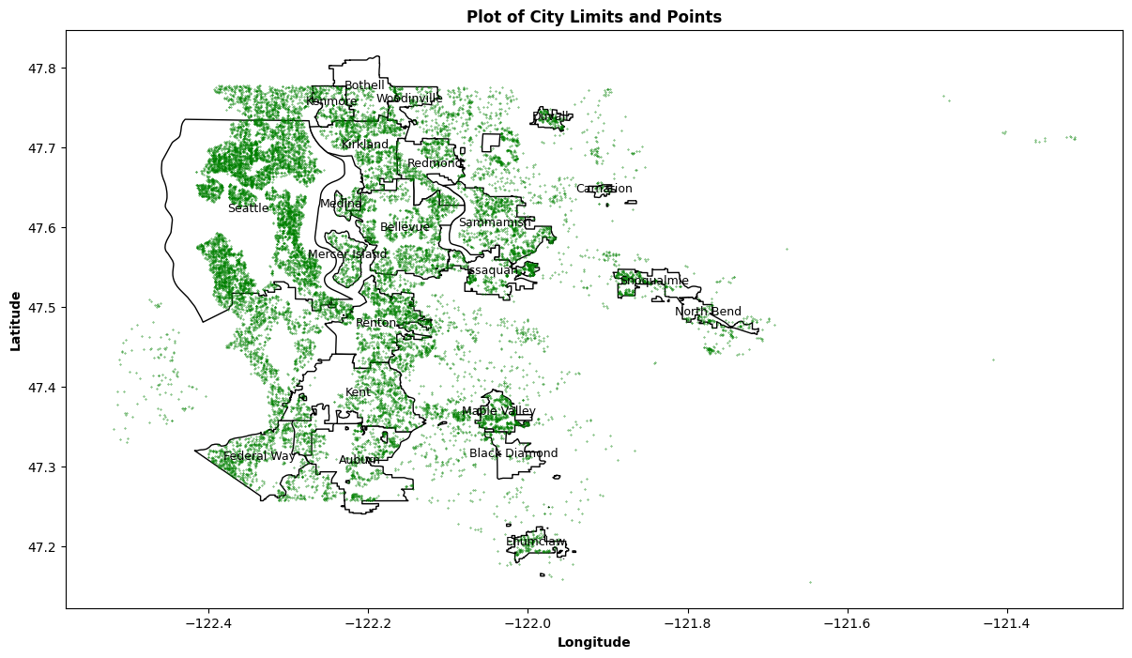

Slide 8
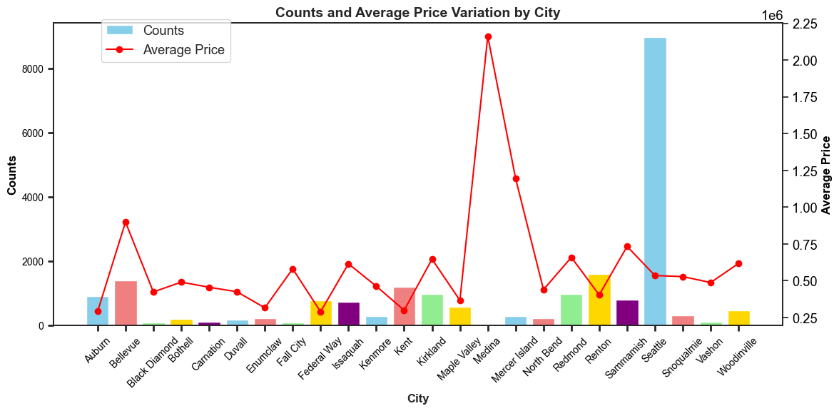

Slide 9
Missing Values in the data
room_bed | 108
room_bath | 108
living_measure | 17
lot_measure | 42
ceil | 72
coast | 31
sight | 57
condition | 85
quality | 1
ceil_measure | 1
basement | 15
living_measure15 | 166
lot_measure15 | 29
furnished | 29
total_area | 68

Slide 10
Statistical summary:
Variable | Mean | Std | Min | 25% | 50% | 75% | Max
Price $ | 540182 | 367362 | 75000 | 321950 | 450000 | 645000 | 7700000
Living Measure (sq. foot) | 2079.86 | 918.496 | 290 | 1429.3 | 1910 | 2550 | 13540
Lot Measure (sq. foot) | 15104.6 | 41423.6 | 520 | 5040 | 7618 | 10684.5 | 1651359
Ceil Measure (sq. foot) | 1788.37 | 828.103 | 290 | 1190 | 1560 | 2210 | 9410
Basement (sq. foot) | 291.523 | 442.581 | 0 | 0 | 0 | 560 | 4820
Living Measure15 (sq. foot) | 1987.07 | 685.52 | 399 | 1490 | 1840 | 2360 | 6210
Lot Measure15 (sq. foot) | 12766.5 | 27287 | 651 | 5100 | 7620 | 10087 | 871200
Total Area (sq. foot) | 17192 | 41628.7 | 1423 | 7032 | 9575 | 13000 | 1652659

Slide 11
Interpretation of Statistical summary of the data:
Price varies from $ 75,000 to $7,700,000, The median (50th percentile) price is $450,000, which indicates that half of the houses have prices below this value.
The lot measure ranges from 520 square feet to 1,651,359 square feet, showing significant variability in the sizes of lots. living measurement, ceil measurement, basement measurement, and total area.
This might mean there are outliers in the data.
The values show lot of variability in the given data.

Slide 12
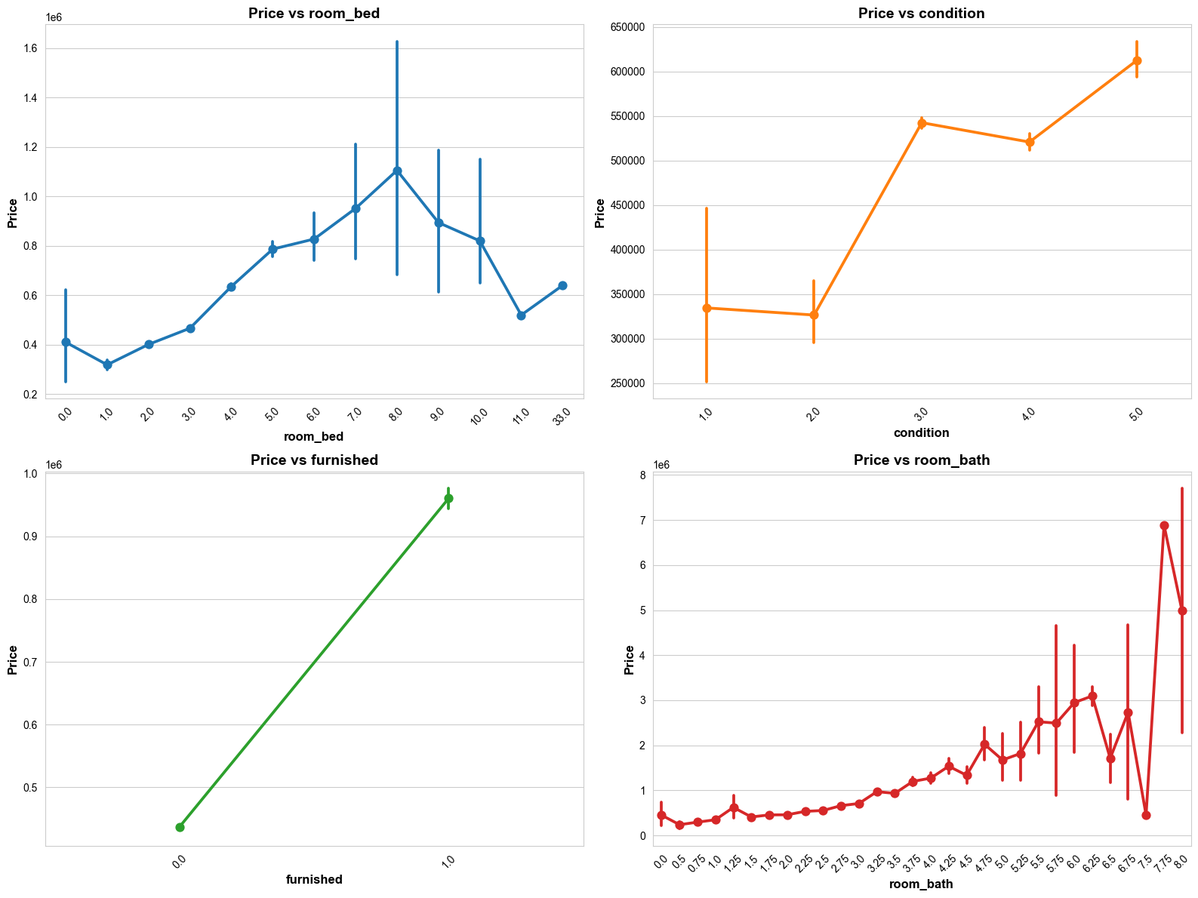
Visualization of Categorical Vs Response variable:

Slide 13
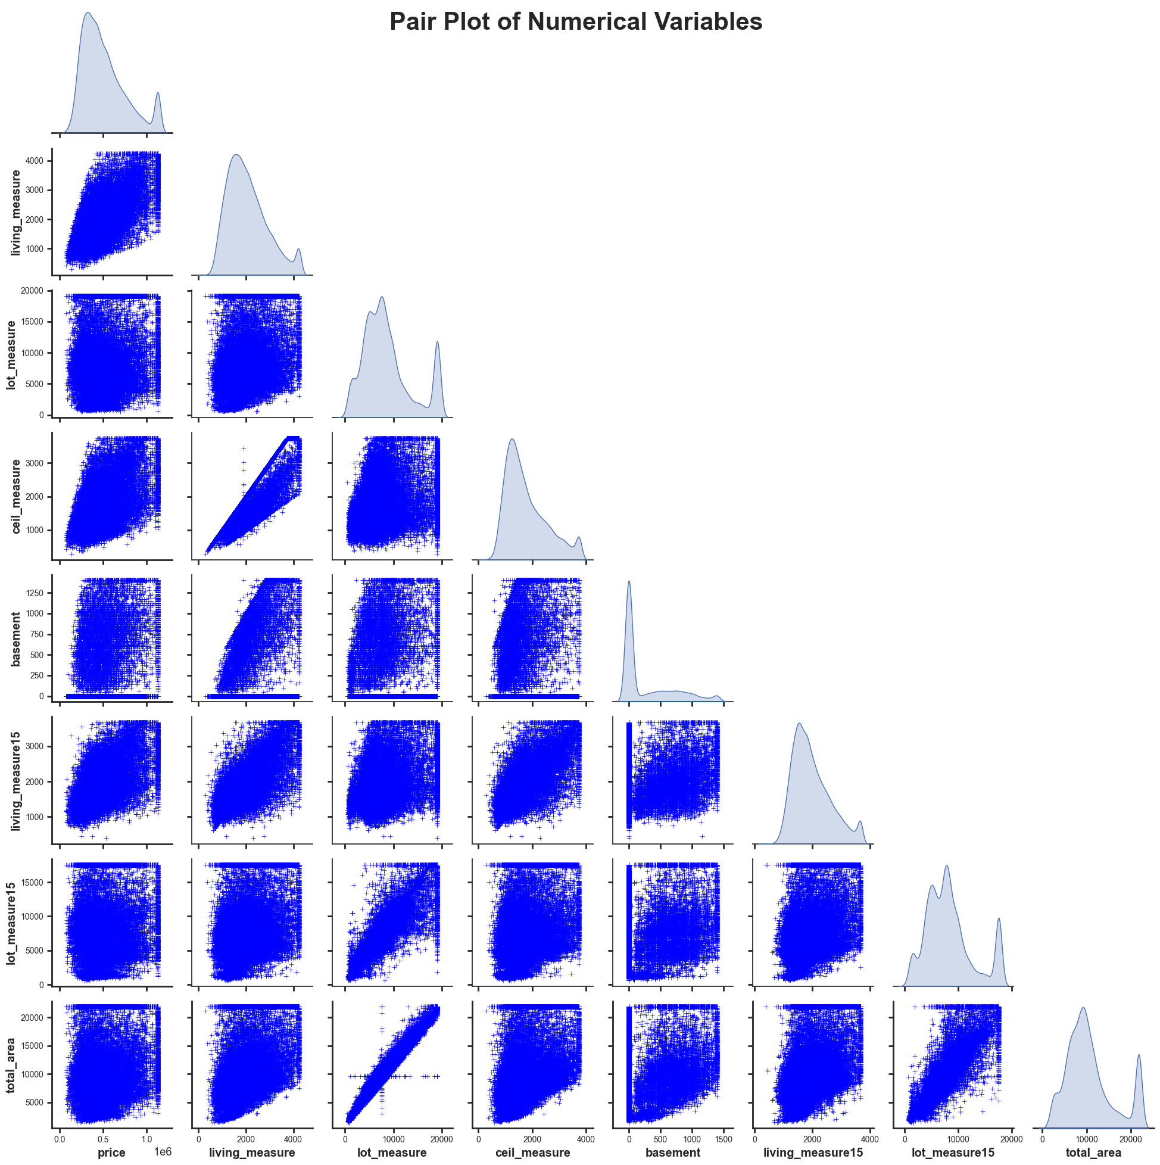
Visualization of Numerical Vs response variable

Slide 14
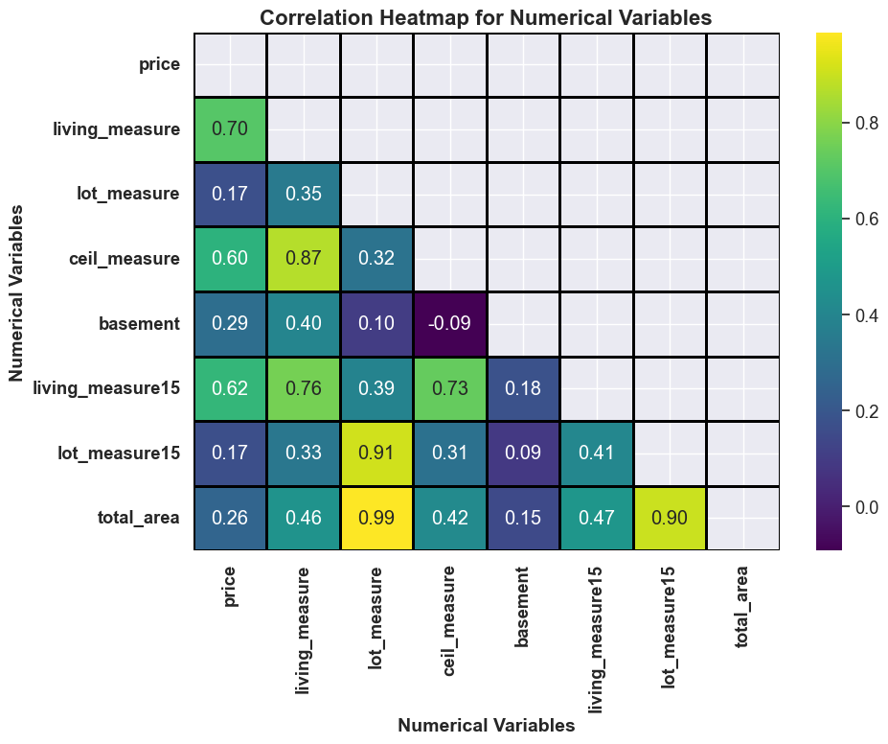
Correlation Heatmap

Slide 15
Inference from Visualization:
The built year of the properties range from 1900 to 2014.
There are only 13 properties that have the highest quality rating.
Majority of the properties have bathrooms in the range of 1.0 to 2.5.
Most of the houses/properties have 3 or 4 bedrooms.
9 properties/houses with more than 8k living measures.
1 property with more than 12,50,000 lot measures.
60% of the properties without basement.
Only 914 houses were renovated out of 21613 houses.
Total area, lot measure, and lot_measure15 give giving same info.
Consider dropping living_measure15 as it's giving the same info as the living measure.
Renovated properties have a higher price than others with the same living measure space.
Furnished houses have a higher price than that of the Non-furnished houses.

Slide 28
Summary
Observed missing values and outliers in data.
Correlation between a few numerical variables, and Independent and response variables.
Different levels of categorical variables effecting the average house prices.

Slide 29
Acknowledgements
Prof. Sumona Mondal
Thevasha Sathiyakumar
Professor Tyler Conlon

Slide 30
THANK YOU

